Slide 1



Naturalistic Research on ChatGPT Experiences
Sylvia Zuniga

Slide 2
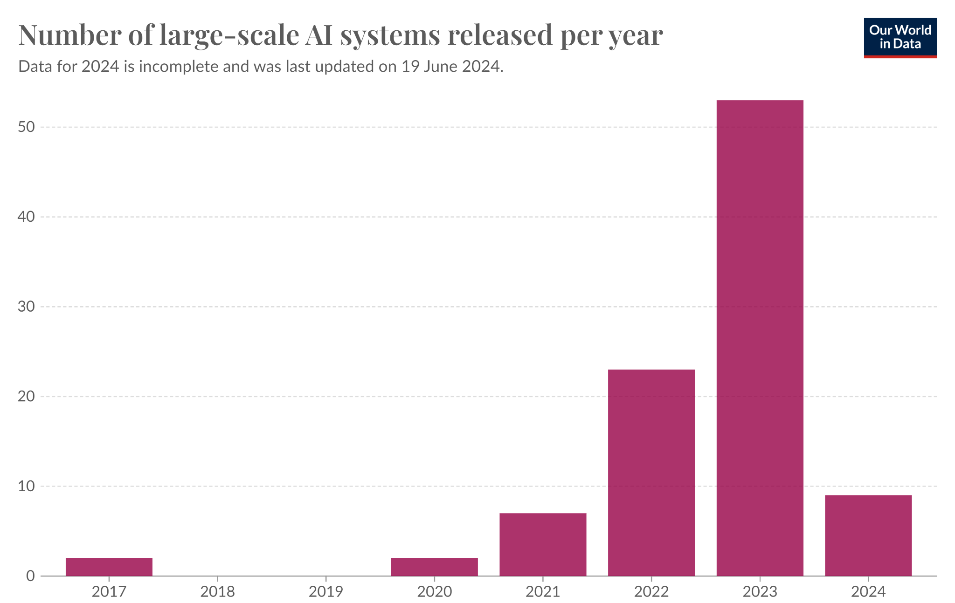
Background
Sources: 10, 9, 4, 5, 3
Notes:
If you merely look around in the world today, we can see that technology is rapidly advancing. What is especially advancing is artificial intelligence. (United Nations, 2020, U.S. Government Accountability Office 2023). The initial boom of AI occurred in the early 2010s but has rapidly increasing ever since, with it recently peaking last year (Jones 2014, Giattino, et al. 2023).

Slide 3
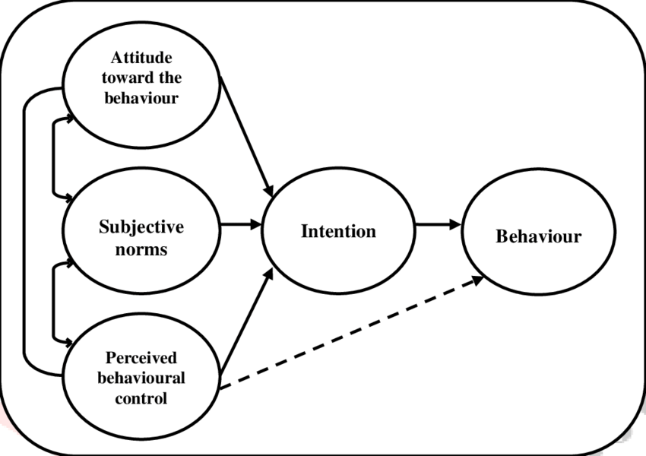
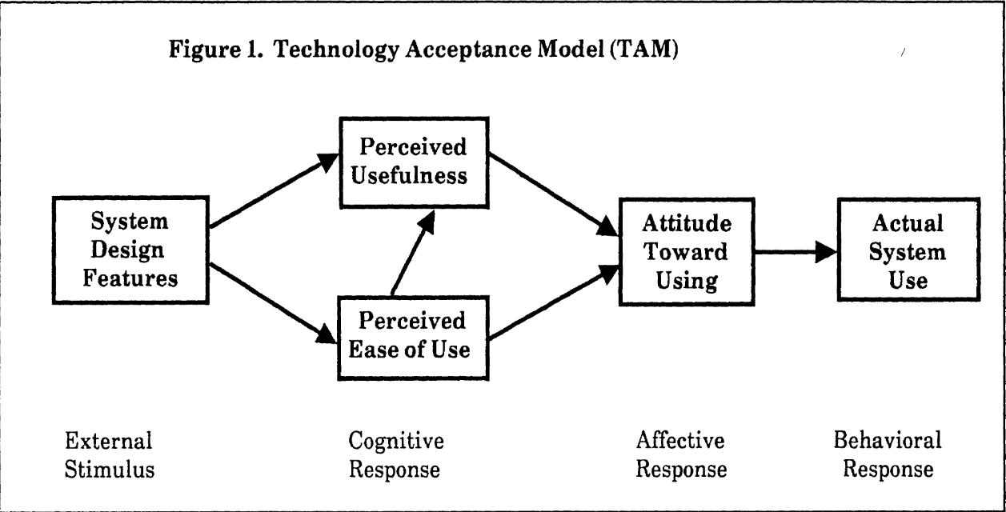
Background
Sources: 10, 9, 1, 2
The theory of planned behavior
Why do we still use AI?
Notes:
But with new technology comes fear. Multiple sources give props to the usefulness of AI but bring up that we should be worried about it capabilities and negative uses (United Nations, 2020, U.S. Government Accountability Office 2023, Stanford University 2024). So why is that even though there is clear fear over this technology that we still continue to use it? On possible explanation is Kevin Davis’ 1989 Technology Acceptance Model. In simple terms, the model explains that we accept new technologies based on its usefulness to us and how easy it is to use. The way the user feels about the technology can help predict whether the technology will be used in the future (Davis, 1989). The aim of the study is not to necessarily replicate results for these theories but to help bridge a gap in norm spreading literature by exploring how norms spread through attitudes.

Slide 4
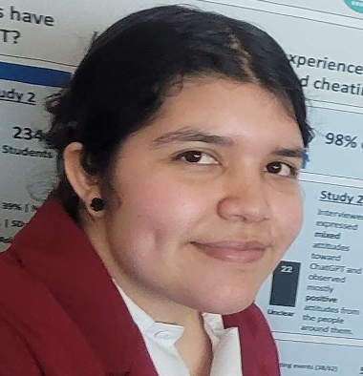
Timeline
Nov. 30th 2022
ChatGPT Release
April-June 2023 (8 weeks)
Study 2: Interview Study
Present
June 25th 2023
Sylvia joins the project
Jan-Mar 2023 (10 weeks)
Study 1: Observational Study
Notes:
Our research focused on the attitudes and uses of ChatGPT a couple months after its initial release in Nov 22nd of 2022.

Slide 5


Study 1: Observational Study
Jan-March 2023 (~10 weeks)
26 Trained Observers
284 Reports
106 ChatGPT Related Reports

Slide 6

Study 2: Interview Study
Interview Questions:
Have you seen anyone using ChatGPT?
Have you heard any people talking about ChatGPT?
What do you think about ChatGPT?
Have you seen anyone using ChatGPT in ways that seemed inappropriate?
Have you seen anyone using ChatGPT in ways that seemed beneficial?
April-June 2023 (~8 weeks)
29 Trained Interviewers
445 Interviewees
234 Students
211 Non-students

Slide 7
Preliminary Results
No final results

Slide 8
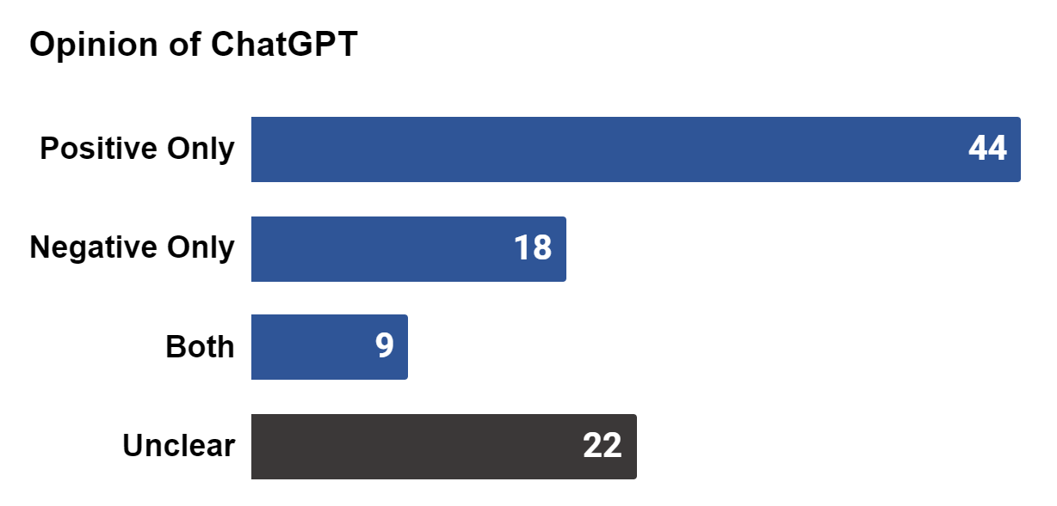
Attitudes Results - S1

Slide 9
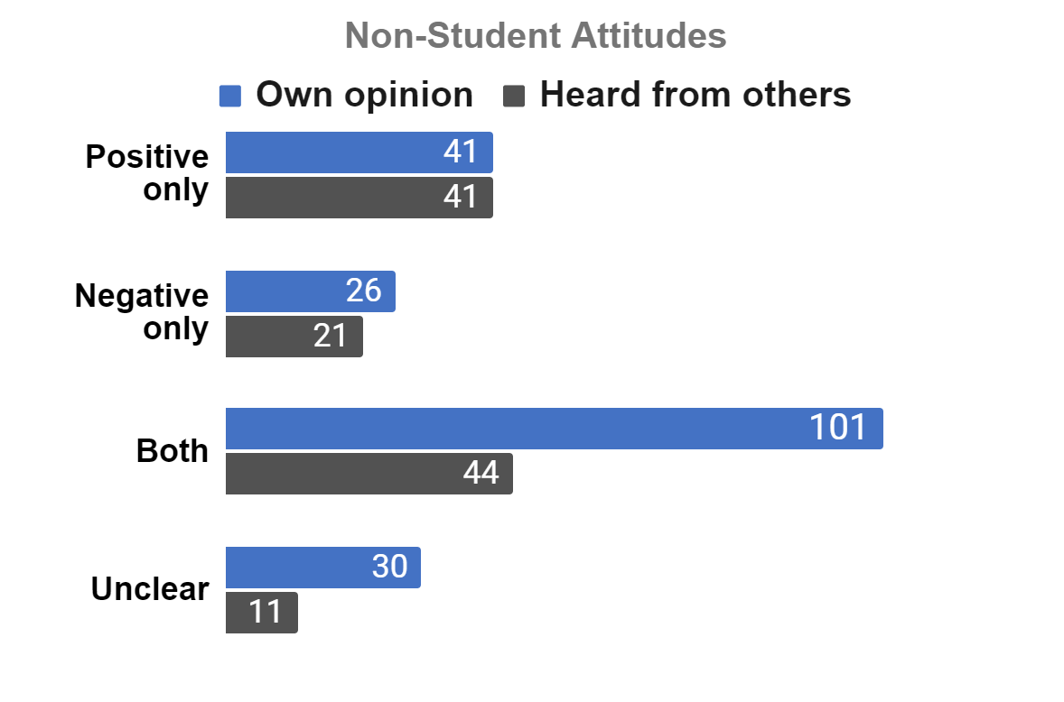
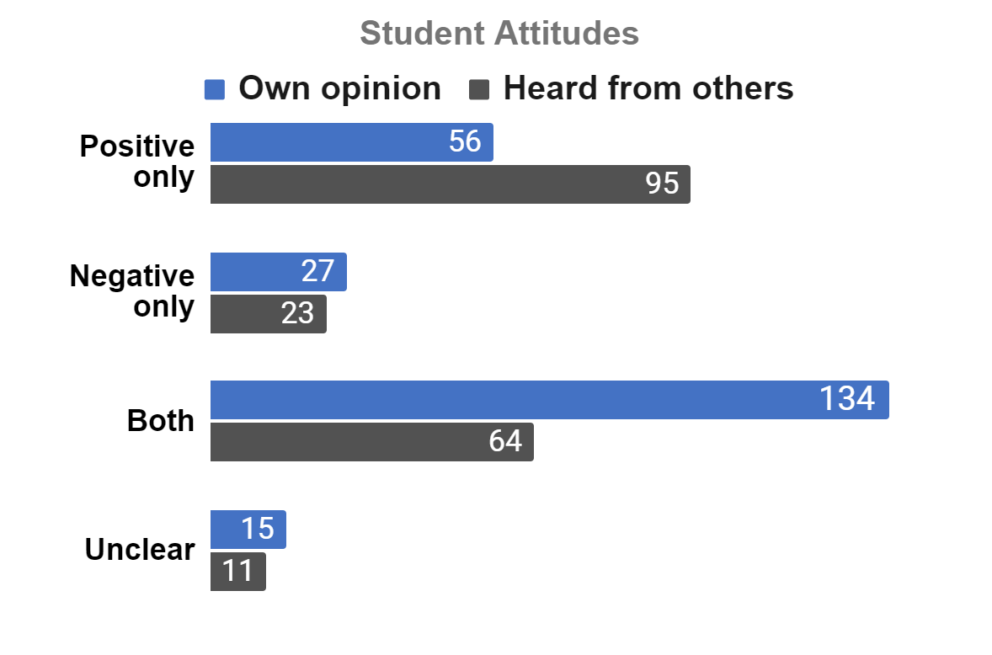
Attitudes Results - S2

Slide 10
Attitudes Results - S2

Slide 11
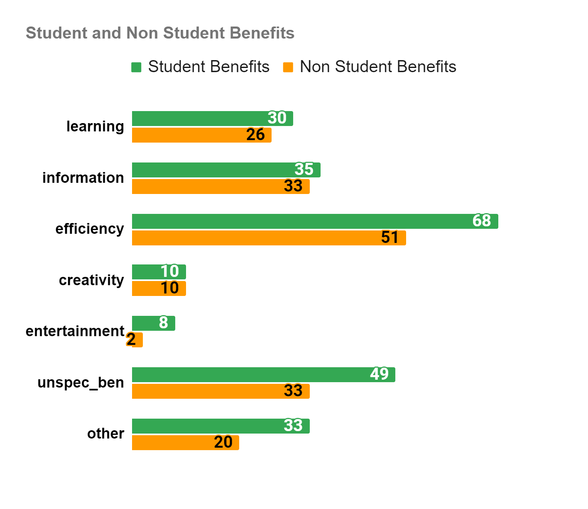
Benefits Results - S2

Slide 12
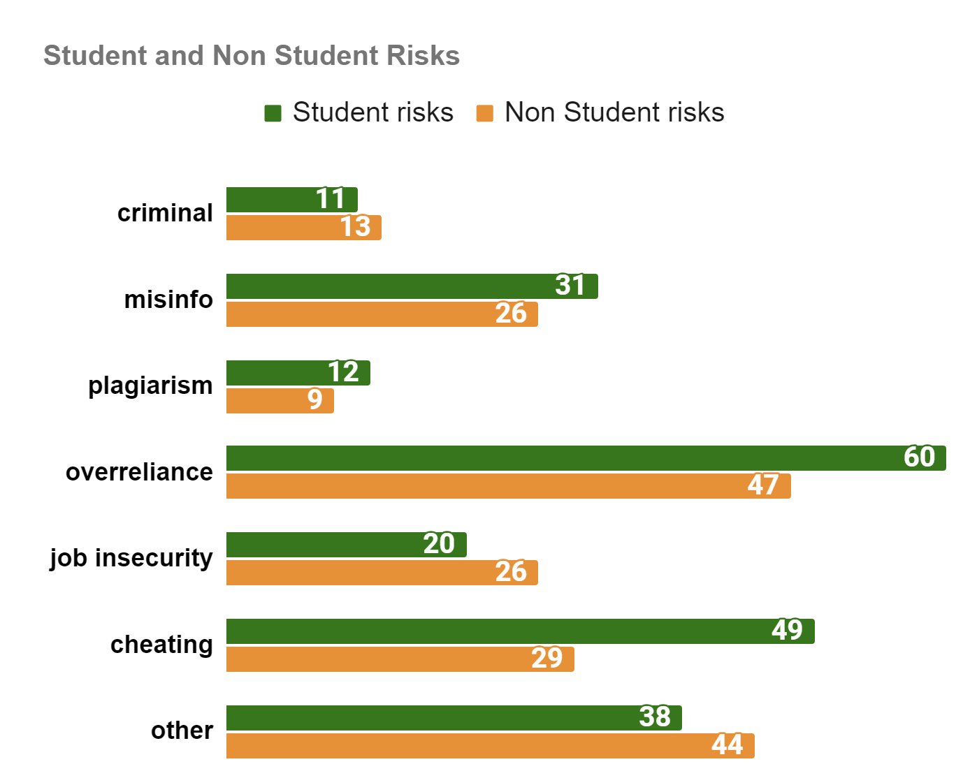
Risks Results - S2

Slide 13
Risks & Benefits Results - S2

Slide 14
Possible Narrative
A view into norm spreading with new things through attitudes and how context contributes to the types of attitudes spread.
Notes:
So the context here is that since most students find the tool useful and are more aware of it/use it more, it make sense that the attitudes they are spreading, and therefore the norm they are spreading, is a positive one.

Slide 15
Possible Narrative
A view into norm spreading with new things through attitudes and how context contributes to the types of attitudes spread.
Possible Implications:
Help policy makers
Help close gaps in norm literature
Future Directions:
Cheating concerns
Students picking up tech (faster?)
ChatGPT social uses

Slide 16


Thank you!
Dr. Tal Waltzer
Special thanks to my mentor Dr. Tal Waltzer, PI Dr. Gail Heyman, the SCDLab, and the TRELS Program for all the support!
Dr. Gail Heyman

Slide 17
Q & A

Slide 18
Sources
Ajzen, I. (1991). the theory of planned behavior. Organizational behavior and human decision processes, 50(2), 179-211. https://doi.org/10.1016/0749-5978(91)90020-T
Davis, F. D. (1989). Technology acceptance model: TAM. Al-Suqri, MN, Al-Aufi, AS: Information Seeking Behavior and Technology Adoption, 205, 219.
Giattino, C., Mathieu, E., Broden, J., & Roser, M. (2023). Artificial Intelligence. Our World in Data. https://ourworldindata.org/artificial-intelligence
Jones, N. (2014). Computer science: The learning machines. Nature, 505(7482), 146–148. https://doi.org/10.1038/505146a
Jones, N. (2024, April 18). AI Report Shows “Startlingly Rapid” Progress—And Ballooning Costs (Nature Magazine, Ed.). Scientific American. https://www.scientificamerican.com/article/stanford-ai-index-rapid-progress/#:~:text=The%20current%20AI%20boom%20%E2%80%94%20built
Stanford University. (2024). The AI index report – artificial intelligence index. In aiindex.stanford.edu. Stanford University Human-Centered Artificial Intelligence . https://aiindex.stanford.edu/report/
OpenAI. (2023). ChatGPT (Dec 23 version) [Large language model]. https://chat.openai.com/chat
Rinta-Kahila, T., Penttinen,E., Salovaara A., Soliman, W., and Ruissalo, J. (2023). The vicious circles of skill erosion: A case study of cognitive automation. Journal of the Association for Information Systems, 24(5), 1199-1357, doi: 10.17705/1jais.00829
U.S. Government Accountability Office. (2023, September 6). Artificial Intelligence’s Use and Rapid Growth Highlight Its Possibilities and Perils | U.S. GAO. Www.gao.gov. https://www.gao.gov/blog/artificial-intelligences-use-and-rapid-growth-highlight-its-possibilities-and-perils
United Nations. (2020). The impact of digital technologies. United Nations. https://www.un.org/en/un75/impact-digital-technologies#:~:text=Digital%20technologies%20have%20advanced%20more

